Slide 1



Data Analyst
01
02
03

Slide 2


Introduction
Hotel Booking Cancellation Analysis & Prediction
Your Name :Resort Hotel , City Hotel
Date : 12/12/2025

Slide 3

Problem Statement
:Cancellations lead to
→ Direct revenue loss
→ Inefficient inventory & staff planning
→ Risk of overbooking and unhappy guests
Hotels suffer from high cancellation rates (up to 40% in some properties)

Slide 4

Project Objectives
1.Clean and prepare the hotel booking dataset (119,390 rows)
2.Perform in-depth Exploratory Data Analysis (EDA)
3.Identify key factors driving cancellations
4.Build an interactive dashboard
5.Provide actionable recommendations to reduce cancellation impact

Slide 5

Data Overview
Dataset: Hotel Booking Demand
Original Size: 119,390 rows × 32 columns
Time Period: July 2015 – August 2017
Hotel Types: City Hotel & Resort Hotel
Target Variable:is_canceled (0 = Not Canceled, 1 = Canceled)
Original Cancellation Rate: ~37%

Slide 6


Data Cleaning & Preparation
Key cleaning steps performed:
Converted reservation_status_date to date format
Created full arrival_date and new features:
→ total_nights = weekend + week nights
→ total_guests = adults + children + babies
Removed 17 irrelevant/redundant column
Outlier treatment:
→ Removed ADR ≤ 0 or > 250
→ Removed lead_time ≤ 0 or > 365 days
Converted categorical columns to proper type
Final Clean Dataset: ~85,000 high-quality records

Slide 7
Exploratory Data Analysis (EDA) – Key Visualizations
ADR Distribution: Most bookings between €50–150
Box Plot: Canceled bookings have significantly higher lead time
Count Plot: City Hotel has higher cancellation rate than Resort Hotel
Scatter Plot: Longer lead time
→ lower ADR in canceled bookings
Correlation Heatmap: Strongest correlations between total_nights, lead_time, and ADR

Slide 8



Key Insights & Findings
Longer lead time = much higher cancellation probability
Bookings with non-refundable deposits rarely get canceled
City Hotel suffers more cancellations than Resort Hotel
Short stays (1–2 nights) are more likely to be canceled
Peak summer months (Jun–Aug) have both highest bookings and cancellations
Repeated guests almost never cancel

Slide 9
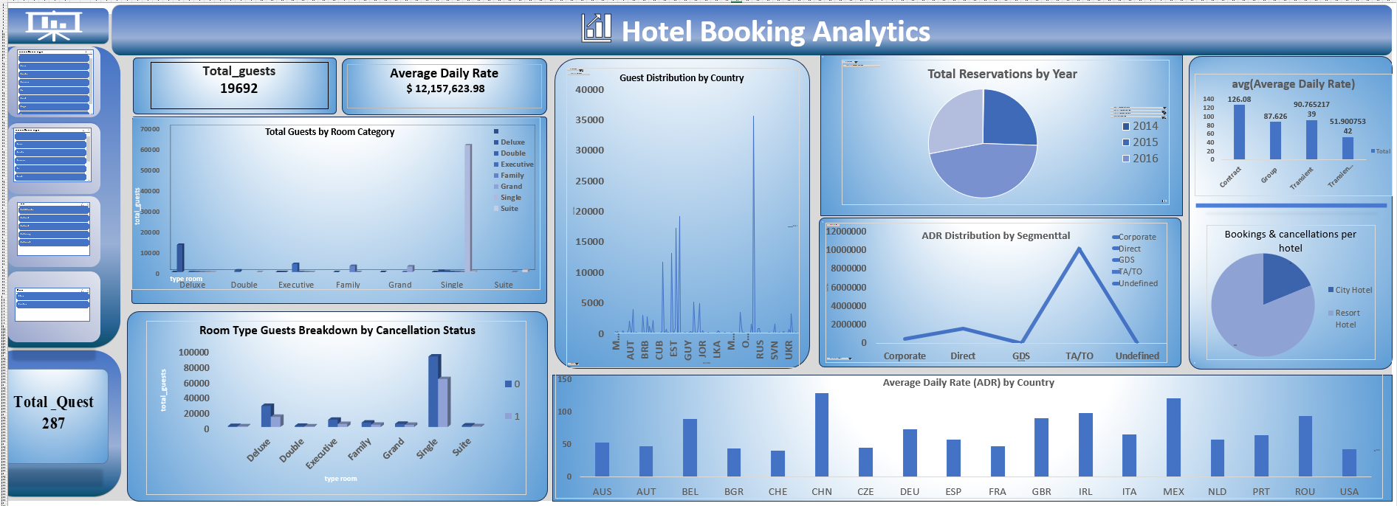
Dashboard

Slide 10

📊 Dashboard Summary
Most booked room: Single
Top guest countries: China, USA, UK
Highest revenue segment: TA/TO
Most bookings: City Hotel
Highest cancellations: Single rooms

Slide 11
Practical Business Recommendations
Apply non-refundable deposit policy for bookings made >90 days in advance
Offer last-minute discounts to fill rooms from expected cancellations
Strengthen loyalty program – repeated guests cancel the least
Allow controlled overbooking (10–15%) in City Hotel during high season
Send automated reminder 30 days before arrival to reduce no-shows
Focus marketing budget on low-cancellation segments (e.g., families, resort guests)

Slide 12
Conclusion
Business Recommendations (Concise):
Make prices dynamic and offer packages to attract new customers.
Introduce a loyalty points program to retain existing customers.
Provide amenities like parking, kids corner, and free internet to boost bookings.

Slide 13
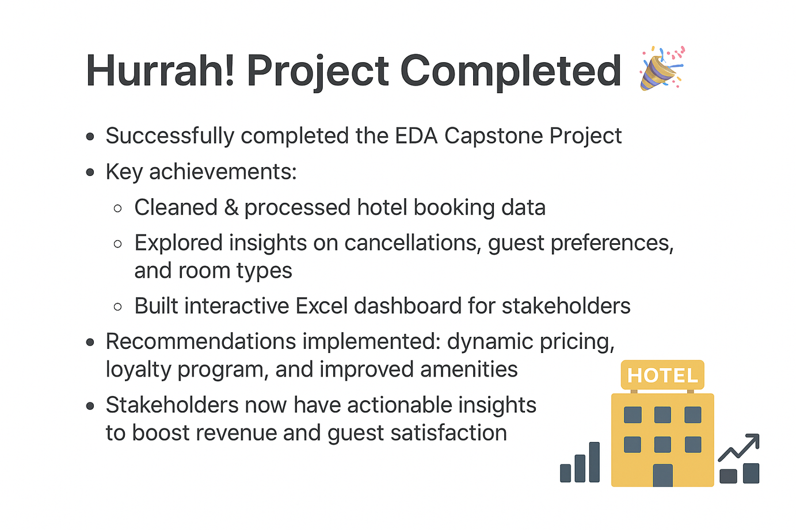
Hurrah! Project Completed 🎉

